Slide 1
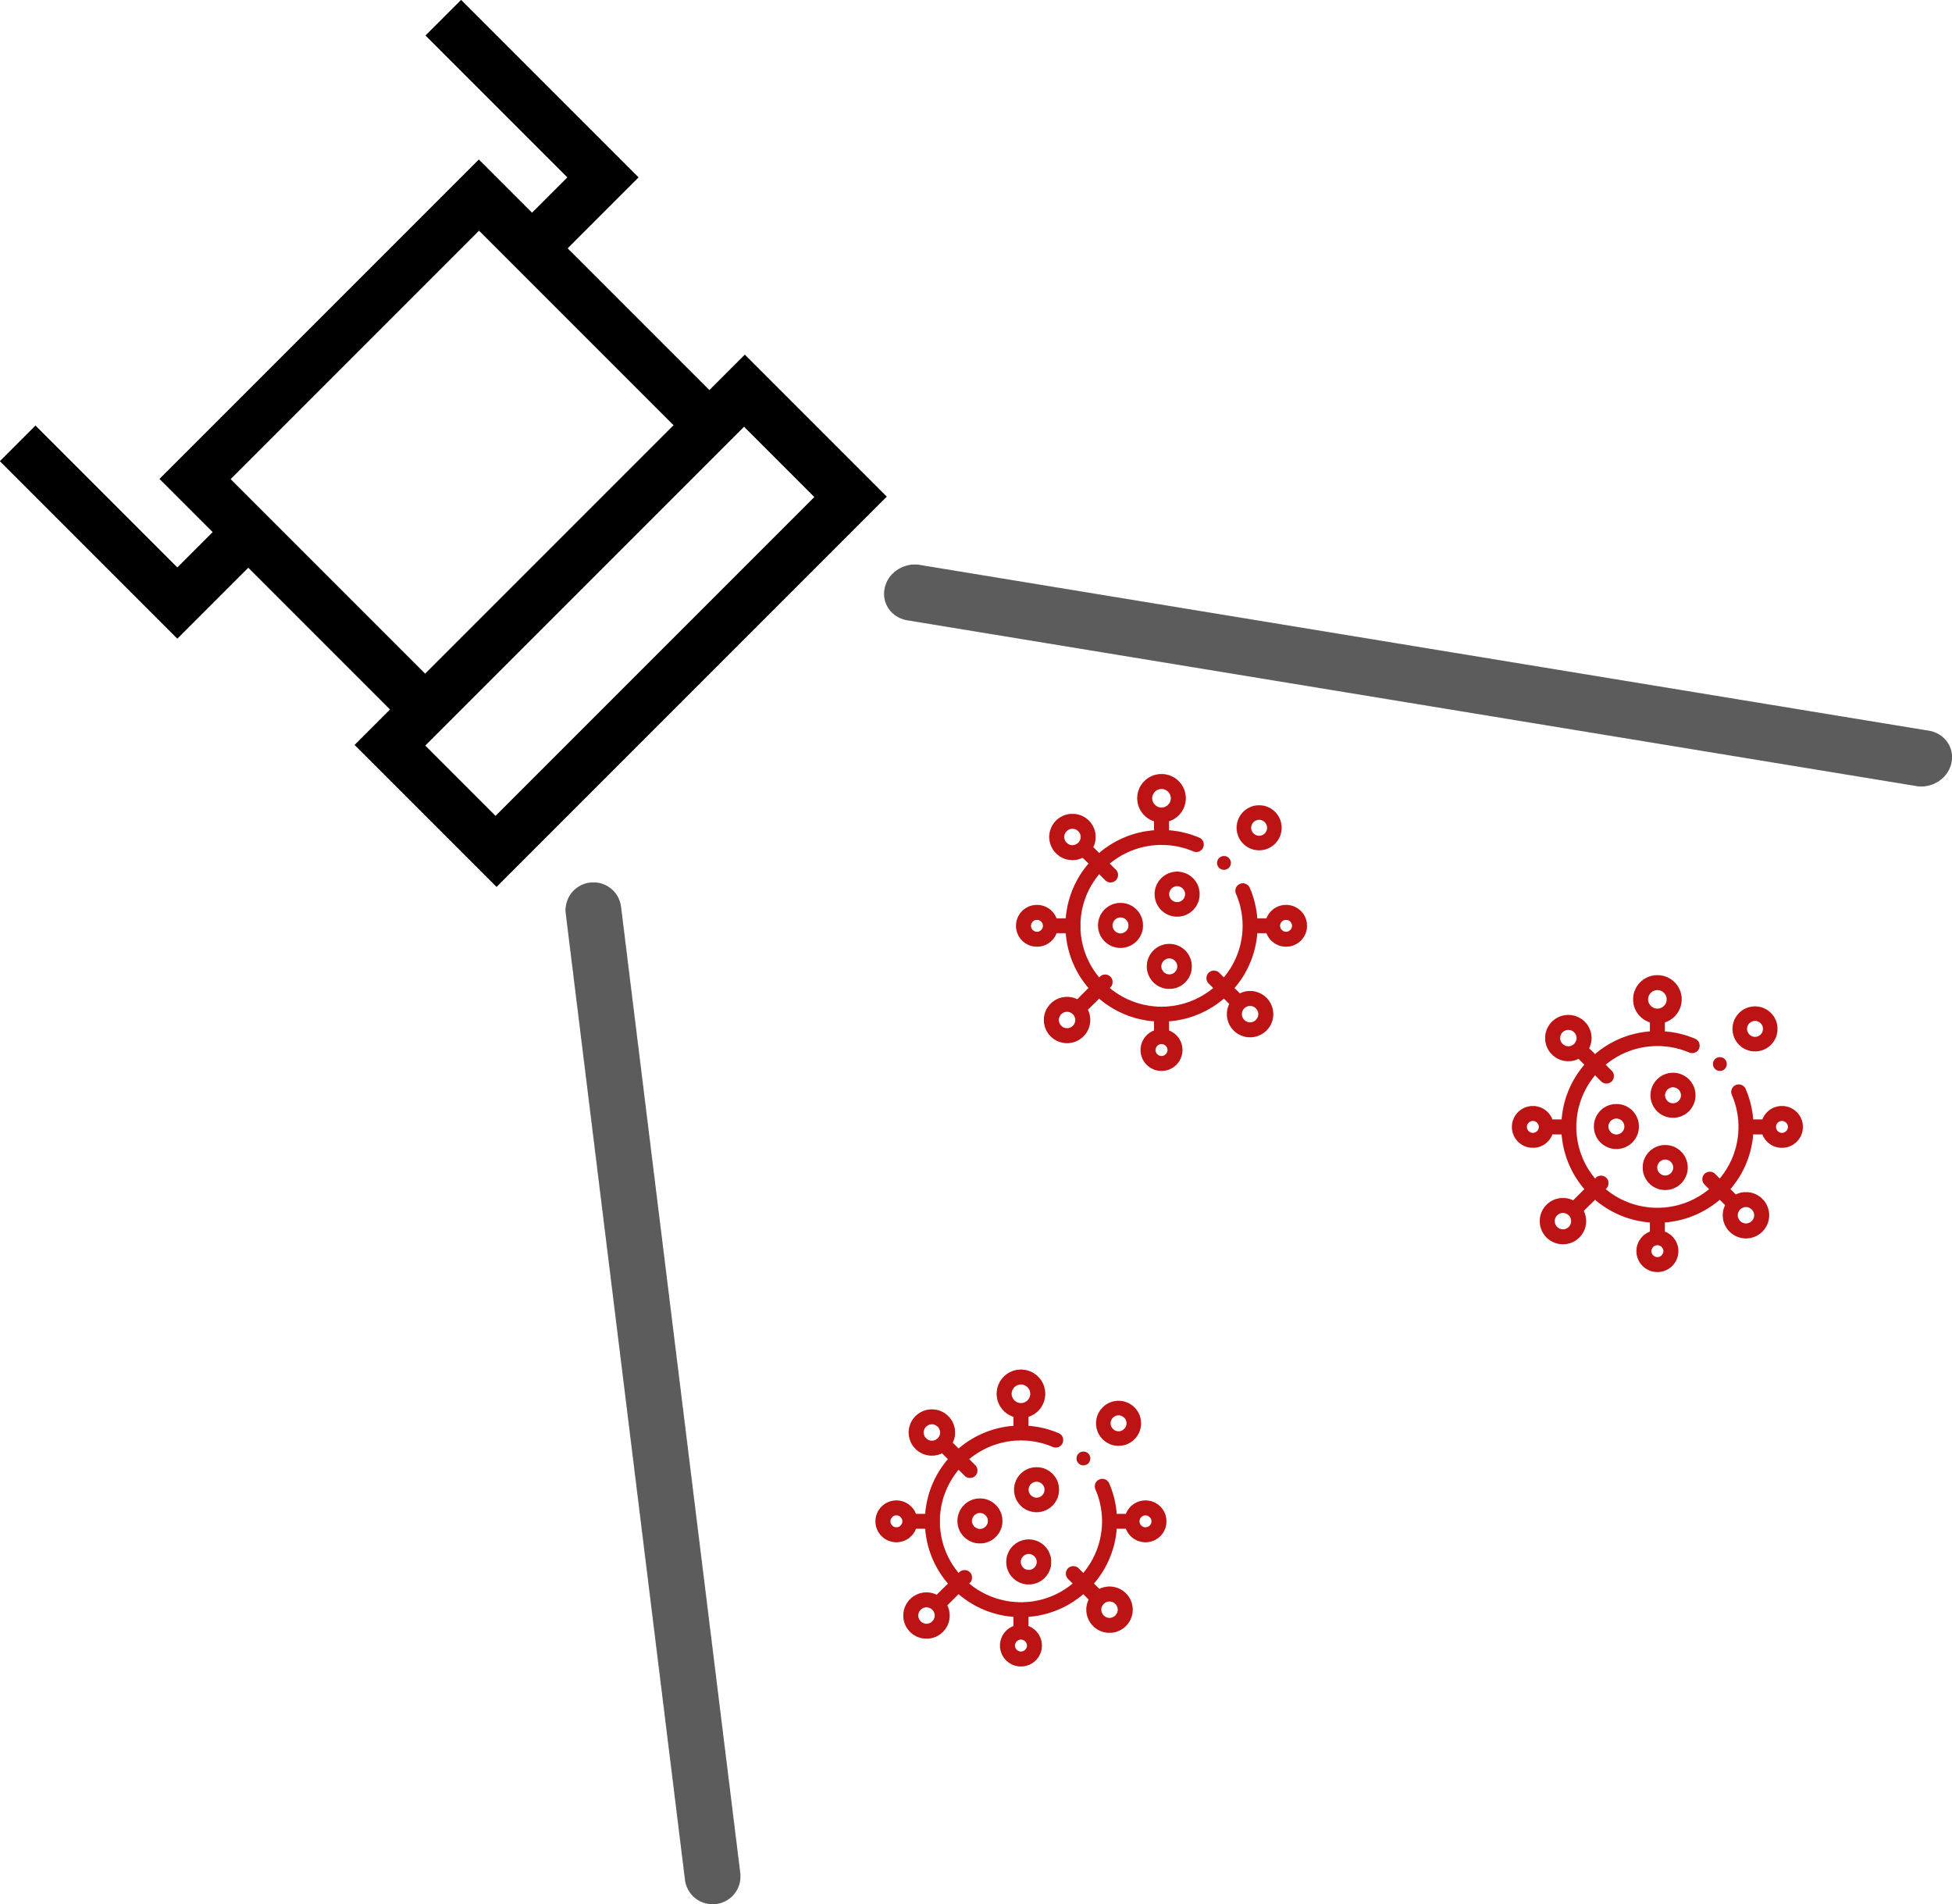
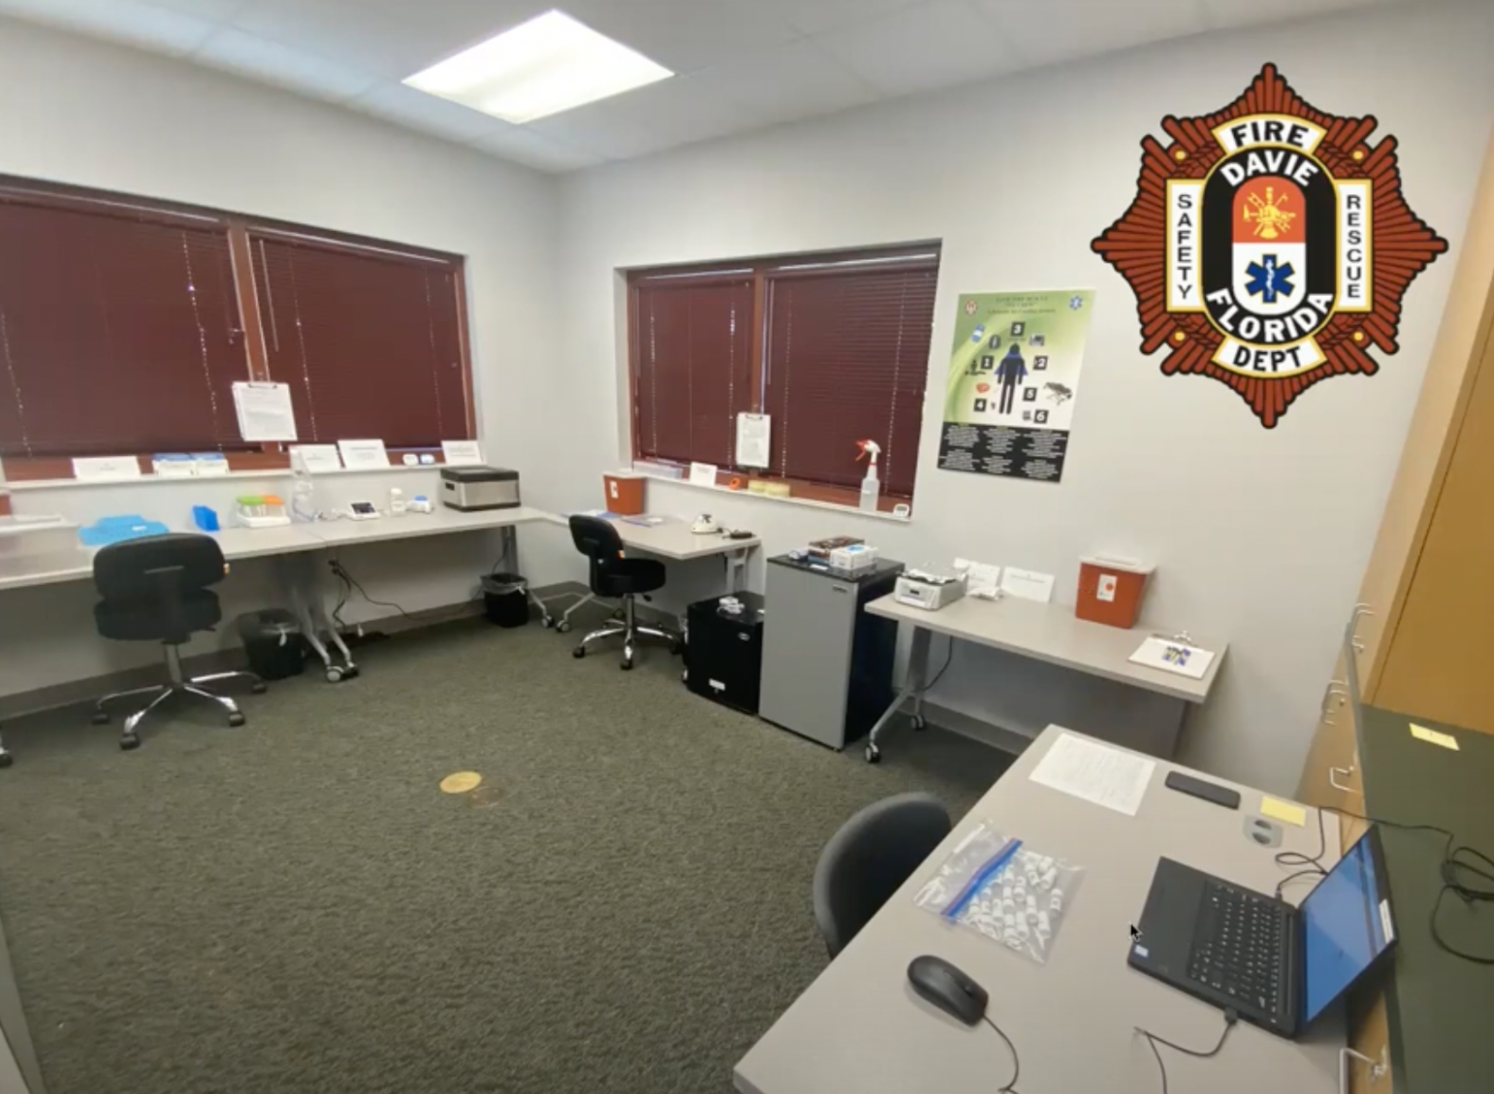
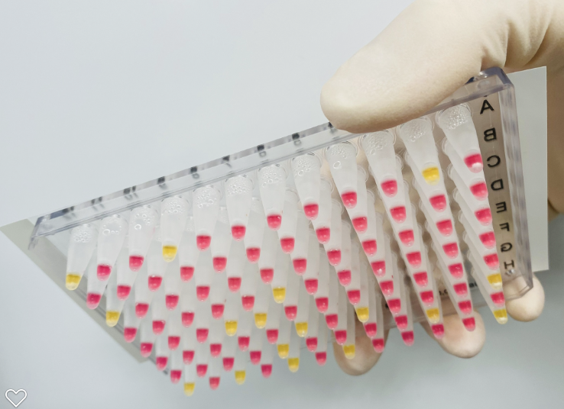
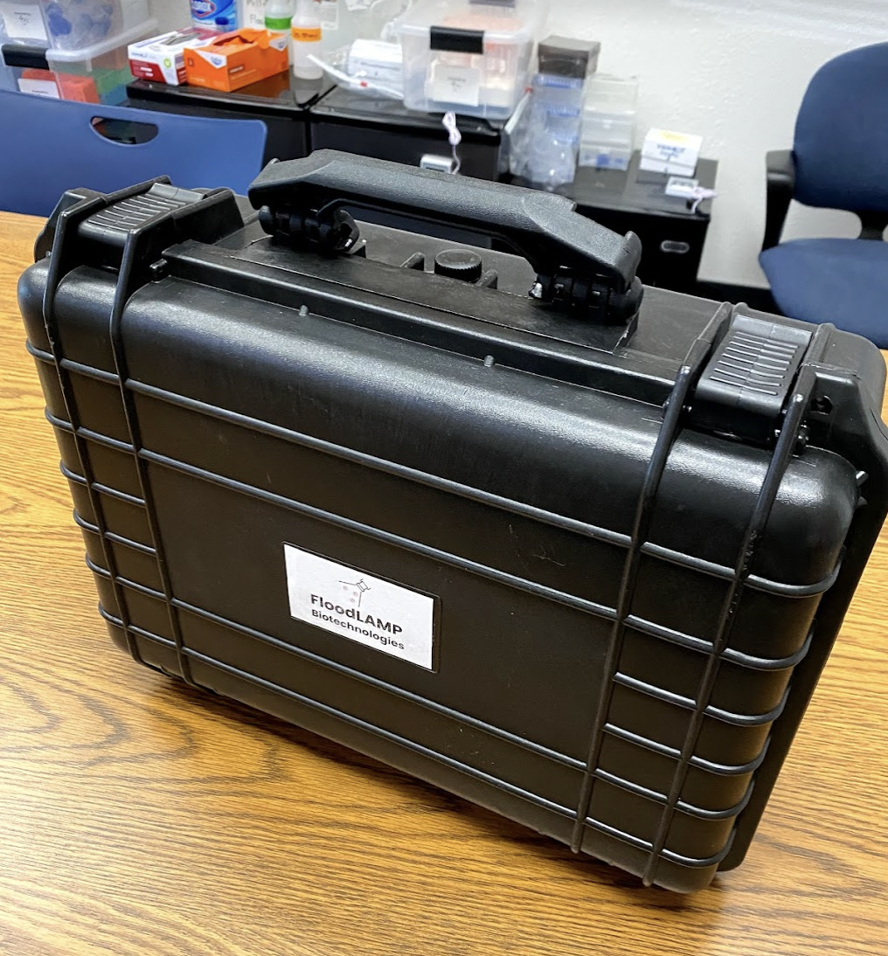
FloodLAMP Rapid Molecular Mass Screening Platform
Randy True (randy@floodlamp.bio), FloodLAMP Biotechnologies, PBC
Solution:
FloodLAMP has developed a vertically integrated platform for rapid molecular disease screening that can quickly scale to massive levels. We've optimized a highly efficient workflow around colorimetric LAMP, and built all the physical and digital components for a turnkey solution that is deployable anywhere in hours.
Demonstrated Success:
We have commercial deployments in 3 states, soon to be 6+, with EMS departments and municipalities. Our programs are very successful and vastly outperforming antigen and lab PCR options. 2 of 3 cities operating FloodLAMP have ramped from testing first responders to mandatory for all employees, multiple times per week.
Value Proposition:
Local control over population level serial screening.
Ideal sensitivity that outperforms antigen on front end and purified PCR on back end of infection.
Improved health and minimized staffing shortages.
Multiple flexible configurations including ultra portable.
Key Deliverables/Risks/Issues:
Section | Description & Status | Deliverable Date
Digital | Launched digital program management App and assets for collection and administration of surveillance screening. | 9/30/21
Quality System | Implement phase1 of quality management system across deployments. | 1/14/22
Training | Ship async training and onboarding material to certify new testing staff quickly. | 1/21/22
Regulatory | 2nd depriotization by FDA for open source EUAs. Seeking support from BARD/RADx. | 2/1/21
Sourcing | Strong relationships with key reagent suppliers. Seeking agency support for sourcing key consumables at scale. | 1/28/21
Staffing | 3 FT, 2 PT, many advisors. Hire 10 new FT staff to support high volume roll out. | 1/14/22
Funding | Sufficiently capitalize to secure supply, staff and manage demand fluctuations. | 1/15/22
Progress:
6,000+ people screened, 8 systems deployed.
Full FDA EUAs submitted for 2 tests, duplex PCR and colorimetric LAMP, as open source protocol EUAs.
Pre-EUA submitted for clinical study of pooled home collection w/ FloodLAMP Mobile App, IRB approved.
FloodLAMP Mobile App available in Apple and Google App stores.
Key IP filed as PCT, LAMP primers licensed from Harvard.
Pooled home collection pilot successful with local pre-school, caught 2 families positive, school has moved to mandatory surveillance 2X/week.
Performance Specs:
Stanford Clin Eval: 90% sensitivity, 100% specificity, 12 cp/uL LoD (LAMP EUA)
98% sensitivity, 100% specificity, 3 cp/uL LoD (PCR EUA)
Real World: 100% confirmation of known positives (50+)
only 1 potential false positive from EMS deployments, no known FN
Recent case report 12/31: FloodLAMP caught positive but Detect, Lucira, Accula and BinaXNow all missed, confirmed with PCR and BinaX 2 days later
TAT 40min minimum, 60-75min on batches
COGS and Pricing:
Currently quoting $8/pool ($2 pp) kit price (reagents, plastics, collection kits).
$20/pool ($5 pp) full service screening.
Risks:
The biggest delivery risks are on commodity components such as basic lab equipment (heat block and pipettes) and lab consumables (tips and PCR plates). We have secured nonstandard components (mastermix, primers, controls, swabs) at large volume, and have creative options for standard unsecured components.
Funding:
FloodLAMP has raised XXX from seed investors, and done over $100k in sales with local government pilot sites.
Customers:
FloodLAMP has partnered with Cities of Coral Springs and Davie Florida, Sacramento Metropolitan Fire District, City of Bend Fire and Rescue Department to protect their critical human infrastructure with locally controlled testing capability.
Inventory:
* pending agency
supply chain
support
 | On Hand | 3 Weeks | 6 Weeks+
Primers | 450,000 reactions 1.8M tests | 1.25M reactions 5M tests | 5M+ tests weekly
Consumables | 50k tests | 500k tests* | 5M+ tests weekly*
Equipment | 20 systems | 100 systems | 1,000+ systems

